Slide 1
REGISTERING FOR
ONLINE BANKING
Right click the box & Open Hyperlink to view DCI University Auto Enrollment video.

Slide 2
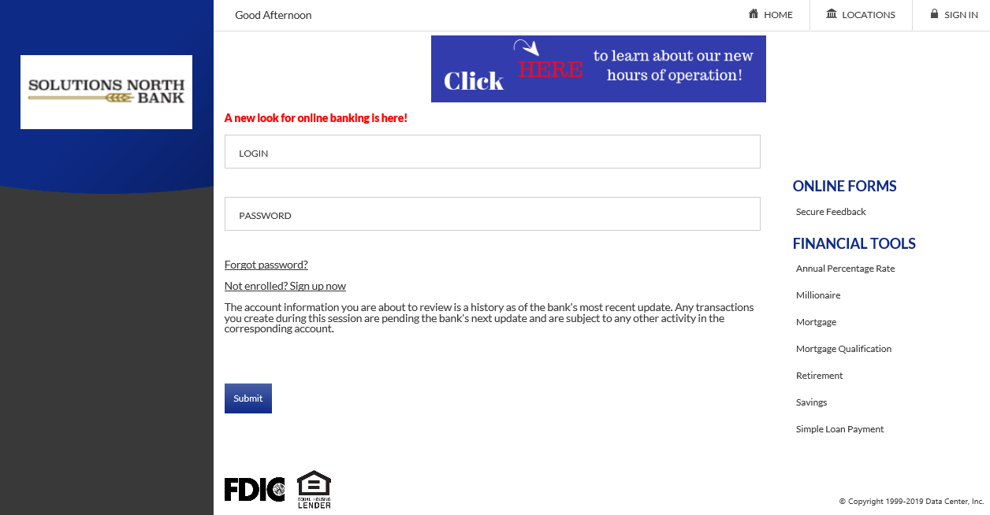
1). Click on ‘Not Enrolled? Sign up Now’.

Slide 3
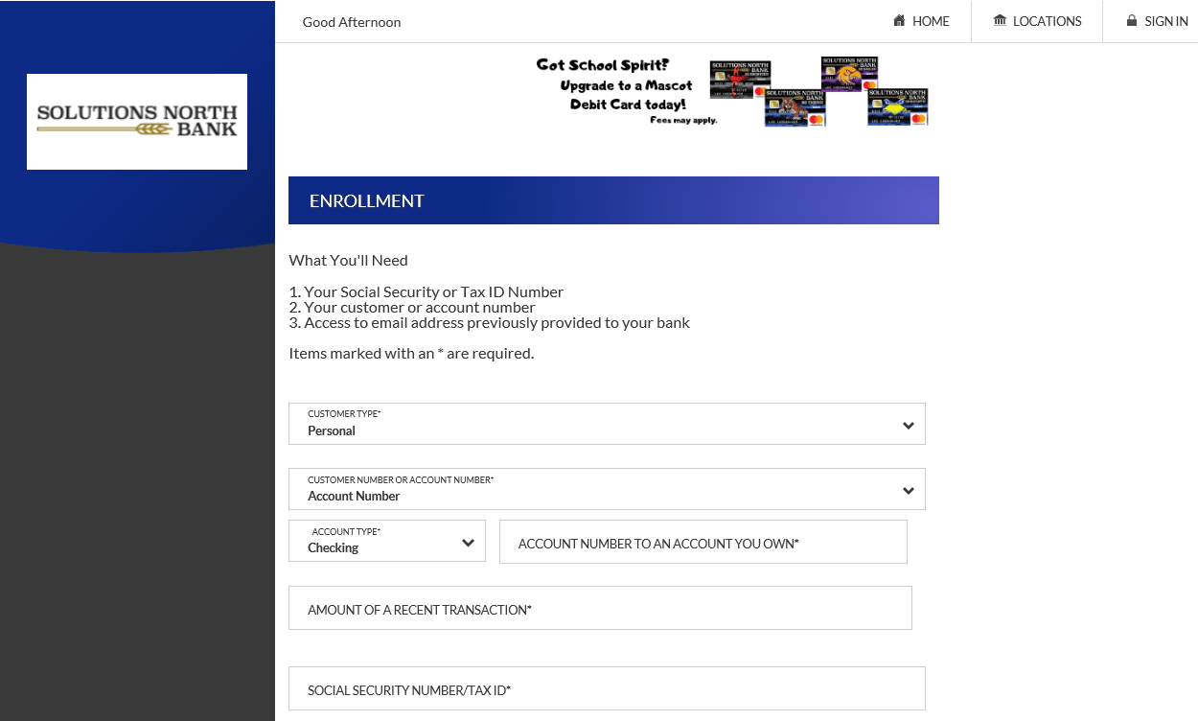
2). Fill out the fields.

Slide 4
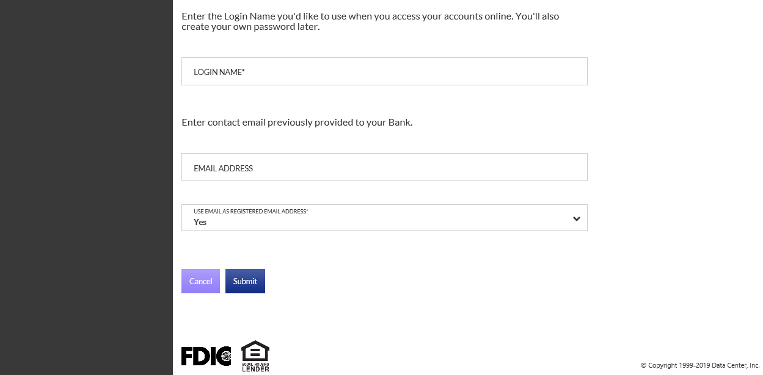
2). Finish filling out the fields & click Submit.

Slide 5
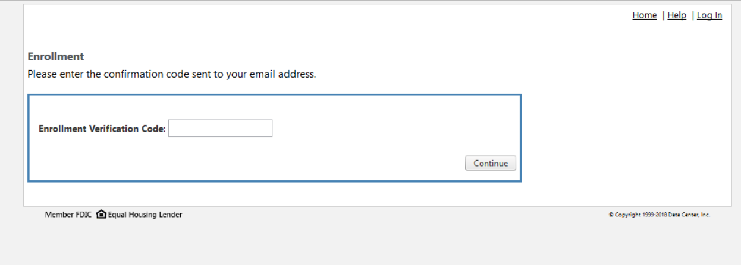
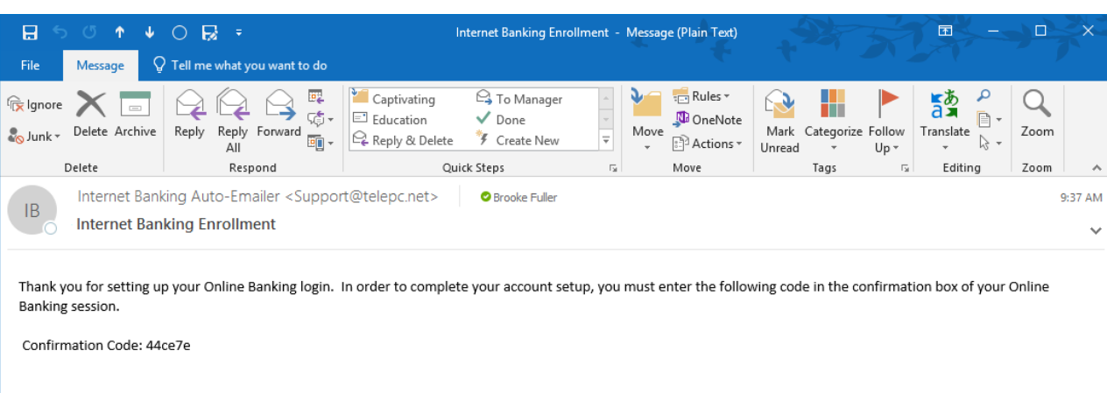
3). You will get a verification code sent to your email. Enter this code & click Continue.

Slide 6
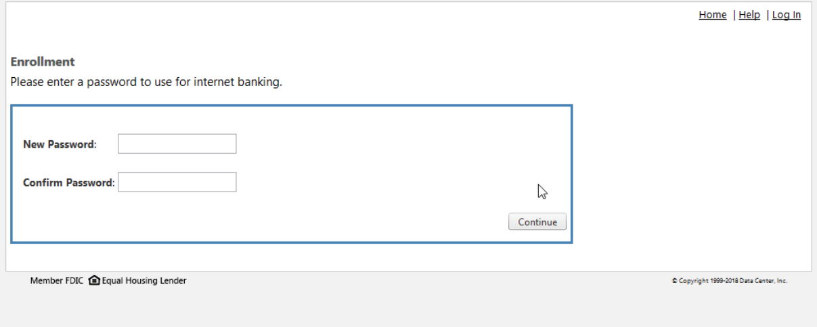
4). Enter a password & click Continue.

Slide 7
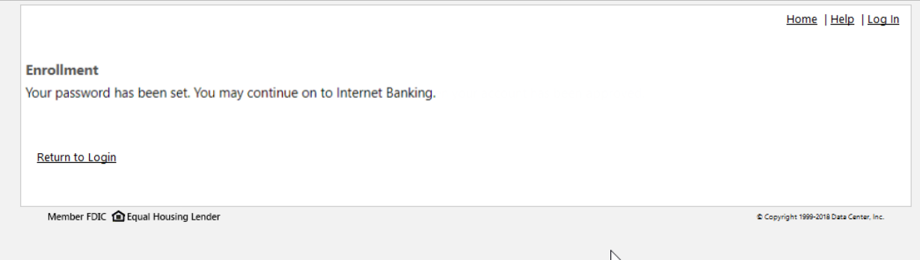
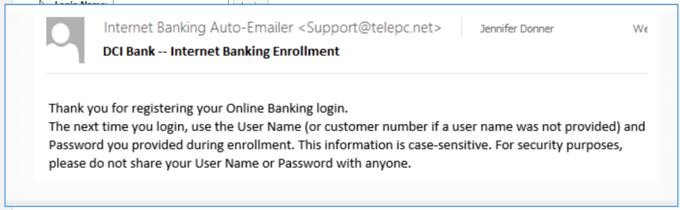
5). Bank will get notified of this enrollment. If all fields are filled out correctly, customer can go ahead and login. Otherwise, bank employee will review information and either decline or accept enrollment. If accepted, customer chooses Return to Login and can login.

Slide 8
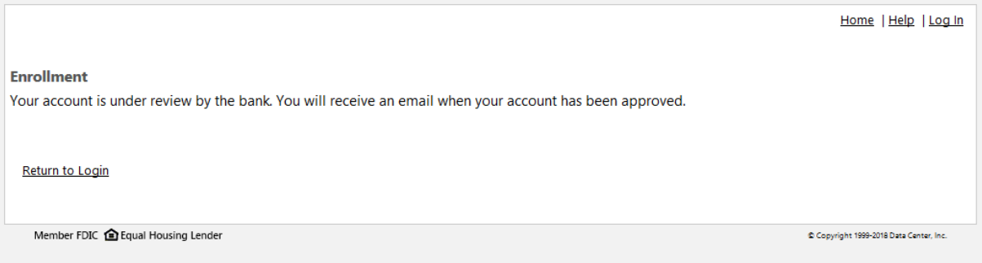
6). Customer will get this notification if there are any discrepancies. Bank employee will review information and either decline or accept enrollment. If enrollment is approved, they will receive an email stating like prior slide & can login.

Slide 9
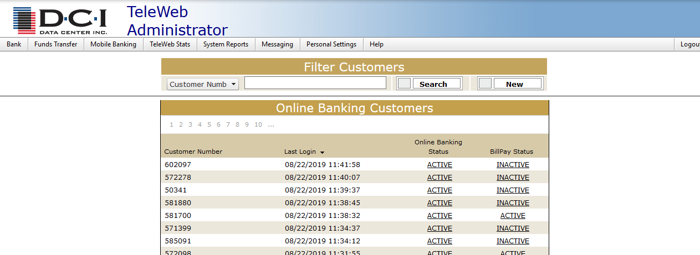
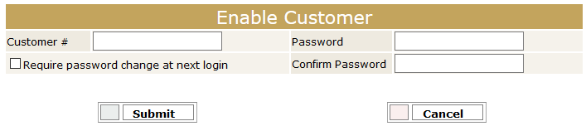
Bank employee also has the option to create a new user through Teleweb Admin using their Customer number and giving them a temporary password. Just go to the Bank tab and click on Customers. Then click on the ‘New button’ which will take you to the screen at the bottom of slide.

